Slide 1
Unit 4
Environmental pollution
Lecture 16
(Cause, effect and control of water, soil and noise pollution. Major soil pollutants and their impacts on human health. Basic concept of Eutrophication and biomagnification. Ill effects of fireworks)
1

Slide 2
Learning outcomes
After completing this lecture, you will be able to understand the following:
Student get knowledge about different type of pollutions, their effect and solutions.
Student understand the basics about ill effect of fireworks.
2

Slide 3
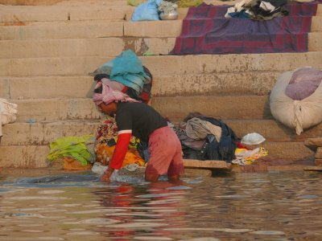
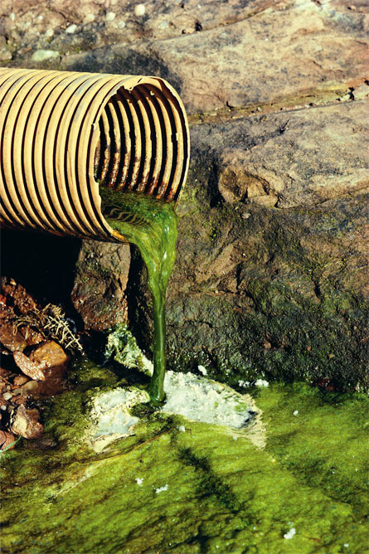
Water Pollution
The addition of various organic and inorganic substances that change the physical and chemical properties of water thereby leading to detrimental effects on living organisms and reducing water usability is termed as water pollution.
https://www.youtube.com/watch?v=KqZihghcMJA
3

Slide 4
Causes of Water Pollution
Natural Causes-
Soil erosion due to rain, floods, high speed wind.
Deposition of dead and decaying remains of plants and animals.
Man-made Causes-
Sewage and other wastes- Includes papers, cloth, soap, detergents, waste.
Industrial waste- effluents such as oil, grease, plastic, metals, acids and other toxic chemicals.
Agricultural waste – fertilizers, pesticides.
Human activities – bathing, clothing, washing.
Customs and traditions- disposal of dead bodies, immersion of idols of gods.
https://www.youtube.com/watch?v=85I7oPWUuak
https://www.youtube.com/watch?v=mLbDbmmV6Qc1
4

Slide 5
Which of the following salts is the main cause of permanent hardness of water?
(a) Magnesium sulphate
(b) Magnesium bicarbonate
(c) Magnesium carbonate
(d) None of the above
Notes:
a

Slide 6
Sources of water pollutants
Point sources-Pollutants enter the water at a single point-- sewage treatment plant and factories. These can be regulated through law.
Non point source- pollutants enter the water over large areas--Surface run off, mining wastes, municipal wastes, acid rain and soil erosion.
https://www.youtube.com/watch?v=MQRiLE09tuc
5

Slide 7
Water Pollutants and its effects
Sediments: Excessive amounts of soil particles carried by flowing water, when there is severe soil erosion. Sediments cloud the water and reduces photosynthesis, destroys feeding ground of fishes, clogs reservoirs and channels.
Oxygen-demanding wastes: Organic waste such as animal manure and plant debris that are decomposed by bacteria, from sewage, animal feedlots, paper mills, and food processing facilities. These bacteria deplete the oxygen and causes death of fish.
6

Slide 8
Water Pollutants (contd.)
Infectious microorganisms: Parasitic worms, viruses and bacteria from infected organisms as well as human and animal wastes. They are responsible for water borne diseases.
Organic compounds: Synthetic chemicals containing carbon from industrial effluents, surface runoff, and cleaning agents. These chemicals causes health problems for humans and harm fishes.
7

Slide 9
Which of the following is mainly responsible for the causes of water pollution?
(a) Afforestation
(b) Oil refineries
(c) Paper factories
(d) Both b and c
Notes:
d

Slide 10
Water Pollutants (contd.)
Inorganic nutrients: Substances like nitrogen and phosphorus from animal waste, plant residues, and fertilizer runoff. These nutrients causes eutrophication.
Inorganic chemicals: Acids, salts, and heavy metals like lead and mercury from industrial effluents, surface runoff, and household cleaning agents. They make water unfit for use and harms aquatic life.
8

Slide 11
Radioactive substances: Wastes from nuclear power plants, nuclear weapons production, mining and refining uranium and other ores. Such substances causes cancer and birth defects.
Thermal pollution: Hot water from industrial processes. Heat lowers oxygen demand and makes aquatic life more vulnerable to diseases, parasites. Thermal shock in aquatic organisms.
https://www.youtube.com/watch?v=YUsuQHXWnq0
9

Slide 12
Effects of Water Pollution
Effect on human health-
Various diseases of CNS, damage to liver, brain and kidney.
Diseases caused by contaminated drinking water- Leads to various waterborne diseases such as diarrhoea, typhoid, cholera, infectious hepatitis, jaundice, etc., in human beings
Bacteria–
1)Typhoid—Diarrhea, severe vomiting, enlarged spleen, inflamed intestine.
2) Cholera—Diarrhea, severe vomiting.
3) Bacterial dysentery– Diarrhea
https://www.youtube.com/watch?v=2iFcQkYzthk
10

Slide 13
Viruses-
Infectious hepatitis– Fever, severe headache, loss of appetite, abdominal pain, jaundice, enlarged liver.
Parasitic protozoa-
Amoebic dysentery– Severe diarrhea, headache, abdominal pain, fever.
https://www.youtube.com/watch?v=2-CDcXUACos
11

Slide 14
What is the health effects of excess fluoride in drinking water?
(a) Fluorosis
(b) Toothaches
(c) Lung disease
(d) Intestinal infection
Notes:
a

Slide 15
Effects on animals-
        Harmful chemicals and pollutants in water effect survival of aquatic organisms-- Loss of aquatic biodiversity
Effects on plants-
Nitrate and phosphate fertilizer used to increase nitrogen and phosphate content of soil goes in water and increases the growth of certain plants on surface of water body--Eutrophication of water bodies
Polluted water contains high concentration of heavy metals becomes toxic for plants.
12

Slide 16
Eutrophication
Enrichment of a standing water body by nutrients, such as phosphorus and nitrogen.
Increased photosynthetic activity.
Excessive algae die, they fall to the bottom and gets decomposed. This process requires dissolved oxygen, some fish species die.
https://www.youtube.com/watch?v=LYcKQ2noekk
13

Slide 17
Which of the following is a waterborne disease?
(a) Typhoid
(b) Cholera
(c) Diarrhoea
(d) All of the above
Notes:
d

Slide 18
Biomagnification
Biomagnification is the increase in concentration of a substance, such as the pesticide, that occurs in a food chain. The pollutant enters the first organism in a food chain. When the second organism in the chain consumes the first one, the pollutant too moves into the second organism.
As we go up the levels of the ecological pyramid, there is energy loss. Hence, at each succeeding level, the predator consumes more of the prey. As a result, the organisms at higher levels have greater concentrations of the pollutant.
14

Slide 19
Measuring Water Quality
Biological Oxygen Demand (BOD): This parameter measures the degree of water pollution from oxygen-demanding wastes and plant nutrients. BOD is amount of dissolved oxygen needed by decomposers to break down the organic material. Measured in ppm.
Total Dissolved Solids (TDS): This is a measure of the combined content of all inorganic and organic substances contained in a liquid. TDS is measured for freshwater. Used as an overall indicator of presence of chemical contaminants.
Presence of disease-causing organisms: The number of colonies of coliform bacteria present in a 100 millilitre (ml) sample of water is one measure. There should be no coliform colonies in drinking water.
Chemical analysis: The presence of chemicals like pesticides can be measured by analysis.
15

Slide 20
The main sources of Arsenic in water are ________.
(a) Floods
(b) Fertilizers
(c) Industrial waste
(d) Both b and c
Notes:
d

Slide 21
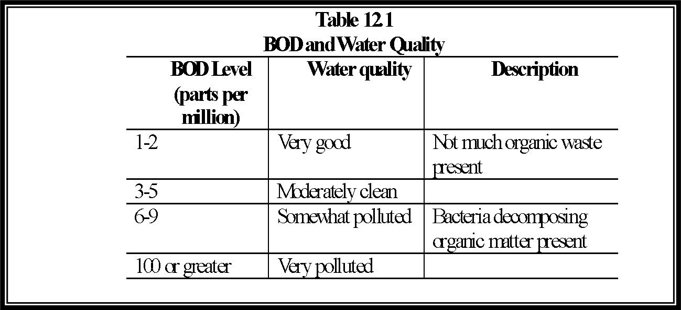
16

Slide 22
Methods of Purifying Water
RO method-water is forced through a semi permeable membrane which filters unwanted substances. RO uses no chemicals.
The UV method- UV radiation is effective in killing bacteria, viruses, certain harmful organisms.
Distillation method- water is boiled to create steam, it condenses to water droplets, which is deposited in a container. The residual water is discarded.
Planted filter method- used to purify sewage water.
17

Slide 23
Which of the following techniques is used for reducing the total dissolved solids (TDS) in the water?
(a) Osmosis
(b) Ion exchange
(c) Distillation
(d) Both b and c
Notes:
d

Slide 24
Control of Water Pollution
Treatment of domestic and industrial waste in order to reduce toxicity.
Control on excess use of fertilizers and pesticides in agriculture
Human activities such as bathing, washing ; throwing dead bodies; immersion of idols should be stopped.
Non- biodegradable waste material such as plastic should not be disposed in water bodies.
Strict enforcement of rules
Public awareness
https://www.youtube.com/watch?v=MYghEiGojk4
18

Slide 25
Land pollution
Land pollution is the degradation of the Earth's land surface through misuse of the soil by poor agricultural practices, mineral exploitation, industrial waste dumping, and indiscriminate disposal of urban wastes .
Examples of Land pollution :
Soil Pollution
Waste Disposal
19

Slide 26
Soil Pollution
Any change in the physical, chemical, and biological properties of soil due to natural or anthropogenic activities is known as soil pollution.
Major Soil Pollutants and their effects
1) Heavy Metal
2) Dioxins
3) Pesticides, fertilizers n other agricultural products
4) Lead, Cadmium
https://www.youtube.com/watch?v=Hnfdq2htoKU
20
Notes:
Dioxins are a group of highly toxic chemical compounds that are harmful to health. They can cause problems with reproduction, development, and the immune system. They can also disrupt hormones and lead to cancer. Known as persistent environmental pollutants (POPs), dioxins can remain in the environment for many years.

Slide 27
Causes of Soil Pollution
Industrial waste – toxic, flammable and non-biodegradable substances that persist in soil and change composition of soil.
Urbanization- Process in which large area of forest n agricultural land are utilized for residential, commercial and industrial purposes. This makes the land unfit for agriculture contributing to soil pollution.
Mining – Process by which valuable minerals are extracted from earth. Mining leads to change in structure and composition of soil and causes soil pollution.
21

Slide 28
Which of the following causes soil pollution?
Industrial waste
Mining
agricultural waste
All of above

Slide 29
Agricultural waste- Excess use of fertilizers and pesticides degrades soil quality.
Domestic waste and garbage- biodegradable waste such as kitchen and food waste, paper, cloth and non-biodegradable waste such as glass, plastic, metal cans etc . Hazardous domestic waste such as batteries, paints, medicines etc.
Radioactive wastes- Nuclear power plants, nuclear testing and explosions add variable amount of radioactive material to soil.
22

Slide 30
Effects of Soil Pollution
Reduces the fertility of the soil
Causes an increase in the number of mosquitoes and flies, which are vectors of several deadly diseases
Reduces the aesthetic value of land
Radioactive elements present in polluted soil enter human body and cause a number of adverse health effects such as cancer, deformities in bones, etc.
https://www.youtube.com/watch?v=Njx7KUZhPrQ
23

Slide 31
Which of the following is an effect of soil pollution?
Reduces soil fertility
reduces aesthetic value of land
spread of dieseases
All of above

Slide 32
Control of Soil Pollution
Treatment of industrial waste before being disposed to reduce soil pollution.
Garbage from urban waste should be segregated into biodegradable and non-biodegradable waste products. Biodegradable waste can be used for production of manures and biogas, non-biodegradable waste can be recycled and reused.
Planting of trees must be encouraged.
Reduction in the amount of radioactive materials released in the soil
Reduction in the use of chemical fertilizers and pesticides
Solid waste can be used for electricity generation.
24

Slide 33
Which of the following is a control mechanism of soil pollution?
Treatment of solid waste
Planting more treees
Reduction of fertilizer use
All of above

Slide 34
Noise Pollution
Refers to loud sound created by humans or machines that disrupts the environment and normal living of organism in it.
The unwanted noise dumped into the atmosphere that leads to discomfort and health hazards is known as noise pollution.
26

Slide 35
Sources of Noise Pollution
Natural phenomena such as violent volcanic eruptions, thunder, fierce storms, etc.
Domestic appliances such as mixers, washing machines, etc.
Industries such mills and factories
Automobiles –music system n constant honking by drivers.
Noise by Trains, ships, and aircrafts
Bursting of crackers and playing loud music during social
gatherings and festivals.
Entertainment devices such as radio, television, etc.
27

Slide 36
Measurement of Sound
Intensity and frequency are the two important properties of sound. The unit of measurement of intensity is decibel (dB)
If we consider frequency, the human ear is known to be sensitive in the frequency range of 20 Hz to 20,000 Hz. However, human ear is more sensitive to sounds of middle frequencies, i.e. 100 Hz.
So, sound level meters used for measuring noise pollution are provided with certain weighting network, are mostly expressed in dB-A rather than dB.
28

Slide 37
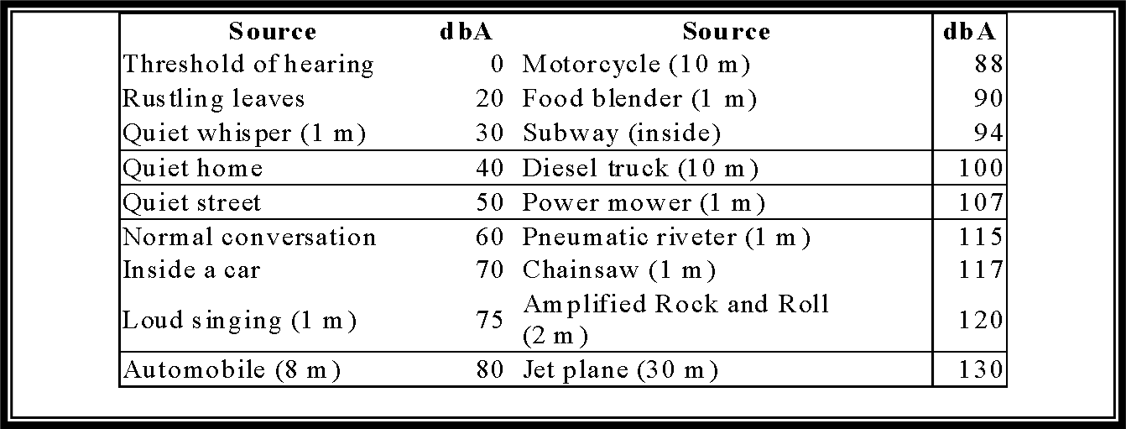
Table : Typical average decibel levels (dbA) of some common sounds
(Where necessary, the distance of the source in metres is specified.)
29

Slide 38
Effects of Noise Pollution
Auditory effect- Exposure to high intensity sound lead to temporary deafness.
Non Auditory Effects-
Physiological disorders like anxiety, insomnia, high blood pressure, increased heart beat etc.
Psychological effect- Depression, Emotional disturbance
Loss of working efficiency- poor concentration and reduces ability to think.
Decline in the number of migratory birds at noisy places
https://www.youtube.com/watch?v=FmxECiGNjZs
30

Slide 39
Control of Noise Pollution
Workers in factories should be provided with ear plugs and ear muffs.
Vehicular noise can be reduced by keeping the engine clean.
Industrial noise can be reduced by keeping the machines well serviced.
Noisy machines should be placed in special glass or wooden cabins.
Special silencing devices should be designed for aircraft engines.
More number of trees should be planted since they are effective sound absorbers.
Public awareness should be created.
31

Slide 40
Acoustic Zoning
Increased distance between the source and receiver by zoning of noisy industrial areas, bus terminals and Railway stations away from the residential areas would go a long way in minimizing noise pollution
32

Slide 41
Legislative measures
Strict legislative measures need to be enforced to curb
The menace of noise pollution. Some of them could be:
i) Minimum use of loudspeakers and amplifiers, specially near silence zones.
ii) Banning pressure horns in automobiles
iii) Framing a separate Noise Pollution Act.
33

Slide 42
ILL EFFECTS OF FIREWORKS
Not only on Diwali but there are several other occasions like marriages, election victory, Wining Cricket Match, that we burn crackers and express our joy. Little do we realise that there is an environmental price of playing fireworks. The red glare during a fireworks show creates patriotism and awe into the atmosphere but also fills the same atmosphere with particulates and aluminium.
Fireworks get their splendour from a variety of chemicals, many of which are toxic to humans. They often contain carcinogenic or hormone-disrupting substances. They can lead to considerable air pollution problems due to the release of lot of smoke from potassium and aluminium compounds, which are used to propel fireworks into the air. In order to achieve desirable visual and audio effects fireworks contain a number of harmful chemicals.
34

Slide 43
The fireworks can harm the environment and human health in following ways:
Effect on Environment
Air Pollution - Fireworks lead to air pollution. In the combustion of fireworks, the main component gunpowder gives rise to the solid reaction products such as potassium carbonate, potassium sulphate and potassium sulphide, together with unreacted sulphur. Burning of fire crackers releases toxic gases and pollutants in the air like as sulphur dioxide, carbon dioxide, carbon monoxide etc.
36

Slide 44
Soil and Water Pollution- The fireworks reaction products that are emitted are deposited on the soil, crops and, in standing waters as well. It therefore leads to soil and water pollution.
Waste Generation- Fireworks release considerable amount of waste which poses serious problems. The quantity of garbage released after Diwali is very high. This garbage is hazardous as it includes sulphur, phosphorous, potassium chlorate, and burnt paper of the fire crackers.
37

Slide 45
Effect on Human Health
Accidents- Carelessly handling fireworks can lead to minor and major accidents particularly to children. Accidents can also occur if fireworks are handled incorrectly during sale and use. Every year, fireworks causing fires to shops and markets make headlines. The result is damage to property and man.
Respiratory Diseases -The SPM (suspended particulate matter) levels rise to a large extent during Diwali. It can cause throat, nose & eye related problems which can later transform into adverse health hazards. It has much more severe effects in people with heart, respiratory or nervous system disorders. It can aggravate problem for people suffering from cold, allergies or coughs and can also cause congestion of throat & chest. Fireworks can cause diseases like chronic bronchitis, common cold, allergic bronchitis, bronchial asthma, etc.
38

Slide 46
Physiological effects due to noise- Not only dust and smoke, bursting of firecrackers leads to noise pollution which is equally harmful and affect the elderly, the sick and children. Too much noise causes anxiety and corresponding stress reactions. Increase amount of noise has harmful effects on animals as well as humans.
Standard decibel level for humans is 60 dB. Increase in the sound level can lead to restlessness, temporary or permanent hearing loss, high blood pressure, anger, heart attack, sleep disturbance, etc. Noise may also lead to hyperactivity in pregnant women, children & those suffering from respiratory problems. Animals and birds are also very badly affected during Diwali by the loud sounds of crackers.
39

Slide 47
Chronic effects of fireworks displays: The colourful displays by fireworks have harmful effects. For example, green light produced in fireworks displays comes from Barium that is radioactive and poisonous, blue colour produced from copper compounds comes from dioxins linked to cancer
https://www.youtube.com/watch?v=tjSN0vuYBb4
40

Slide 48
Control Measures to Minimise Pollution by Fireworks
In order to protect oneself from fireworks pollution and its ill effects, it is necessary to take some corrective measures and path breaking steps. We need to ask ourselves whether “Happy Diwali” is really making our Earth Happy.
Creating awareness about the perils of this careless usage of fireworks seems to be the only way to reduce the pollution. Environment departments must take initiatives to create awareness among masses by posters, pamphlets and slogans highlighting the dangers of fireworks.
41

Slide 49
Government should organize anti-firecracker campaigns and discourage people from bursting firecrackers. Parents as well as children should be educated about the harmful effects of firecrackers and environmental laws should be implemented strictly. By observing ‘Right to Sleep’ as a fundamental right, the bursting of crackers is banned between 10 pm to 6 am.
42

Slide 50
Along with above, some of the measures that can be taken are:
Avoid bursting crackers in the building compounds, narrow lanes and congested areas.
Persons with respiratory diseases should stay indoors to avoid inhaling smoke from outside.
The crackers should not be lit inside the house. Open grounds must be used to light fireworks.
https://www.youtube.com/watch?v=BxAYThjB4z8
43

Slide 51
Important Video and Web Link
https://www.ugc.ac.in/oldpdf/modelcurriculum/Chapter5.pdf
https://www.geo.lu.lv/fileadmin/user_upload/lu_portal/projekti/gzzf/zinas/8.LECTURE-Environmental_pollution.pdf
http://www.ilocis.org/documents/chpt55e.htm
44

Slide 52
Acknowledgment
Some images, animation, and material have been taken from the following sources:
Text Books: PERSPECTIVE IN ENVIRONMENTAL STUDIES by ANUBHA KAUSHIK, C P KAUSHIK, NEW AGE INTERNATIONAL PUBLISHERS
References Book: TEXT BOOK OF ENVIRONMENTAL STUDIES by D. DAVE AND S. S. KATEWA, CENGAGE LEARNING
3 All slides can be used for reading purpose only
45

